Slide 1






Bacchus Winery Case Study
CSD310 11.2 Assignment

Slide 2
Group Introduction
Our Wonderful Team
Daniel Graham
Stephanie Ramos
Aidan Jacoby

Slide 3
Case Study Overview
Bacchus Winery

Slide 4
Bacchus Winery – Business Plan
Stan and Davis Bacchus inherited winery from their Father
Eager to update business practices and transition away from manual bookkeeping
Owners wanted to maintain original staffing
Create a report that shows a yearly production snapshot

Slide 5
SQL Overview
Bacchus Winery

Slide 6
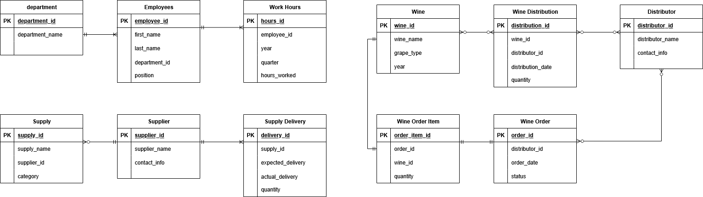
Bacchus Winery – Finalized ERD

Slide 7
Primary Reports
Supplier Delivery Wrap-Up – Are all suppliers delivering on time?
Month-By-Month Report
Wine Distribution Report – Are all wines selling?
Employee Work Report – How long is our team working?
Annual Report

Slide 8
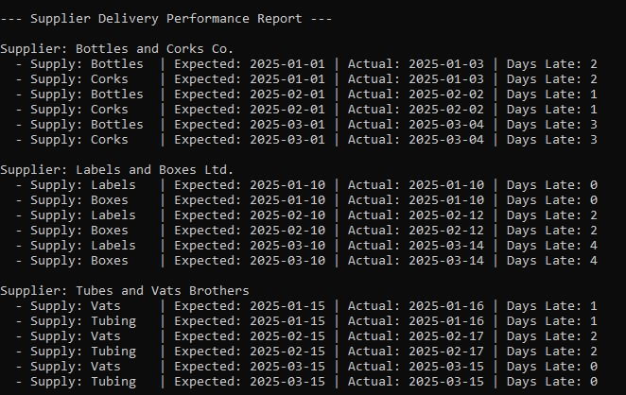
Supplier Delivery Performance Report
Columns Used: supply_name, supplier_name, expected_delivery, actual_delivery
Assumptions Made: Company Names, Dates Used

Slide 9
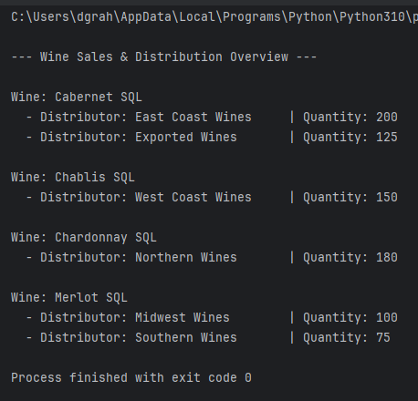
Wine Sales & Distribution Overview
Columns Used: wine_name, distributor_name, quantity
Assumptions Made: Actual Wine Quantities, Distributor Names

Slide 10
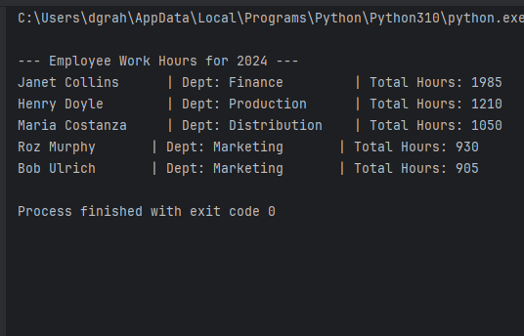
Employee Work Hours Summary
Columns Used: first_name, last_name, department_name, hours_worked
Assumptions Made: Real Hours Worked

Slide 11
Design Assumptions Pt.1
The winery only produces and sells four wine varieties: Merlot, Cabernet, Chablis, and Chardonnay.
No outside grapes are used; all wine is produced using grapes grown on-site.
Each supply item is sourced from a single supplier.
Monthly delivery performance reports are not currently in place but are required to help management identify late shipments.
The system will track both expected and actual delivery dates to support delivery performance analysis.

Slide 12
Design Assumptions Pt.2
Employee work hours are not currently tracked in a formal system, but the company wants to begin recording and reviewing hours worked by each employee on a quarterly basis.
The company does not currently have an online ordering or shipment tracking system for distributors, but this is a desired feature the new system will support.
Each employee works in only one department, and departments are: Finance, Marketing, Production, and Distribution.
Distributors can place one order that includes multiple wine types.
Orders are placed by distributors and include an order date and shipping status.

Slide 13
Thank You
Bacchus Winery

